Slide 1
Organization Cybersecurity Policy and Executive Summary
Ryan Coon
CYB-650
Dr. Howard Goodman
August 27, 2025

Slide 2
CONTENTS
NIST Cybersecurity Framework
Cybersecurity Lifecycle and Methodologies
Organizational Security Policy
Organizational Systems and Network Diagram
Risk Assessment, Business Impact Analysis, and Business Continuity Plan
Comparison of Different Standards
Incident Response and Handling Plan
Cybersecurity Awareness Infographic
Executive Summary

Slide 3
NIST Cybersecurity Framework
NIST SP800-66 Revision 1: An introductory Resource Guide for Implementing the HIPAA Security Rule
Framework provides outline for compliance with HIPAA Security Rule
HIPAA Security Rule requires confidentiality, integrity, and availability of Electronic Personal Health Information
Standards are created to be compliant with HIPAA Security Rule

Slide 4
NIST Cybersecurity Framework
Administrative Safeguards (4.1 - 4.9)
Security Management Process
Information Access Management
Security Incident Procedures
Physical Safeguards (4.10 - 4.13)
Facility Access Controls
Workstation Use and Security
Device and Media Controls
Technical Safeguards (4.14 – 4.18)
Access Controls
Audit Controls
Transmission Security

Slide 5
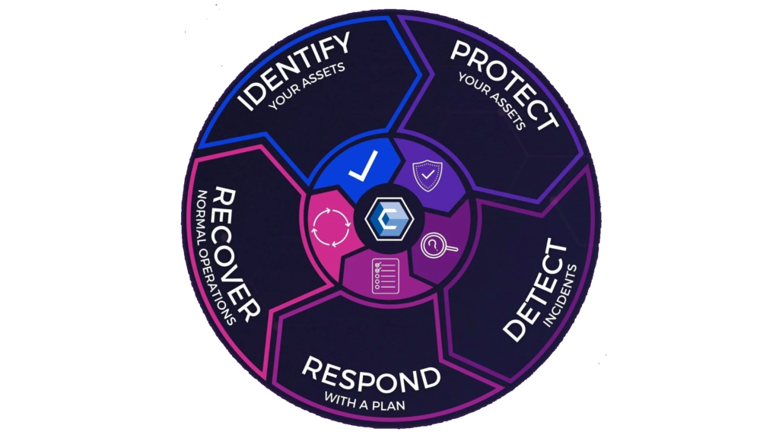
Cybersecurity Lifecycle and Methodologies
Identify – The organizational missions and priorities, assets, and goals
Protect – Implement the NIST Framework, firewalls, multifactor authentication, and employee training
Detect – Monitor network, use IPS and IDS
Respond – Quickly work to analyze attacks, contain attack, eradicate attacking malware
Recover – Restore systems functionality, patch vulnerabilities

Slide 6
Organizational Security Policy
Reflects the organizational goals and priorities
Compliance with standards (HIPAA)
Identifies and protects against attack vectors, including insider threats
Implements comprehensive policies
Acceptable Use Policy
Onboarding and Offboarding Policies
Social Media Policy
Mobile Device Policy

Slide 7
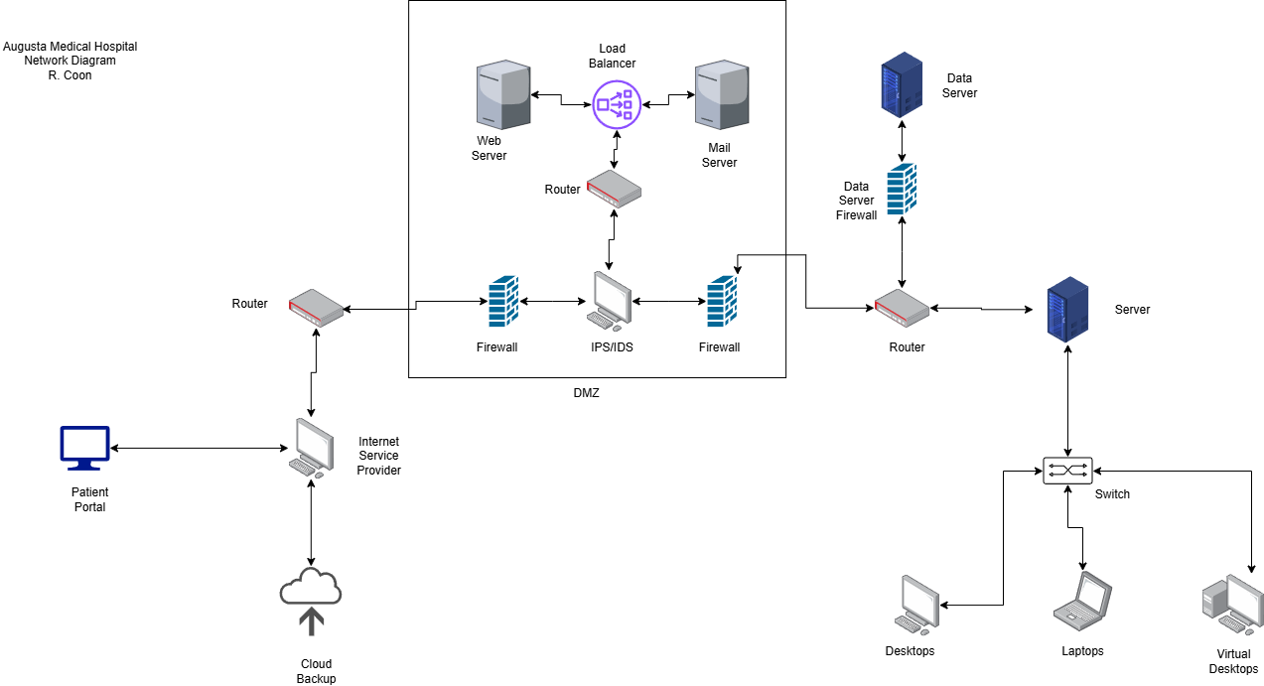
Organizational Systems and network diagram

Slide 8
Risk Assessment, Business Impact Analysis, and Business Continuity Plan
Risk Assessment
Business Impact Analysis
Business Continuity Plan
Identifies vulnerabilities in the network and systems
Identifies threats, threat vectors, and possible targets
Can be conducted as a penetration test
Identifies the effect of a successful attack would have on the organization
Qualitative versus Quantitative Analysis
Consequences – Financial, Reputational, Sanctions and fines
Identifies how to recover or maintain business functions in the case of a disaster
Allows for customization and innovation to meet challenges faced
Goal is business continuity rather than full business recovery

Slide 9
Comparison of Different Standards
HIPAA Security Rule
Ensure the confidentiality, integrity, and availability of all Electronic Personal Health Information that they create, receive, maintain, or transmit
Identify and protect against reasonably anticipated threats to the security or integrity of the information
Protect against reasonably anticipated, impermissible uses or disclosures
Ensure compliance by their workforce
HITECH
Requires the adoption of electronic health records over the antiquated paper records

Slide 10
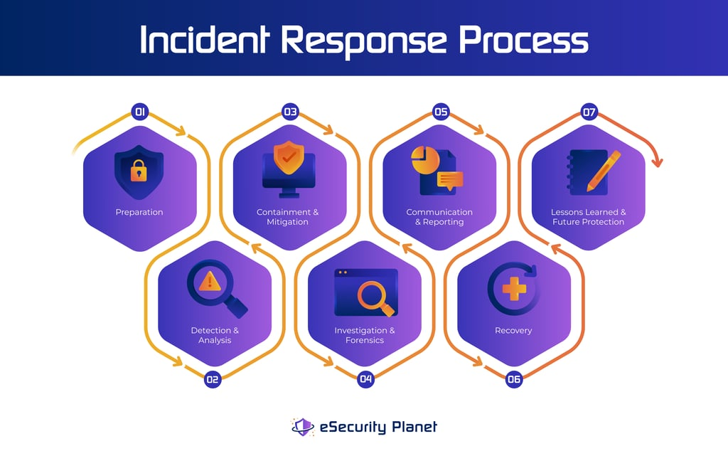
Incident response and handling plan
Incident Response Team
Leader, Coordinator, Responder, Communicator
Planning and responding to incidents, communication with stakeholders and external authorities
Steps of Incident Handling
Preparation (Early Detection)
Analysis
Containment and Mitigation
Investigation and Forensics
Communication and Reporting
Recovery
Lessons Learned and Future Protection

Slide 11
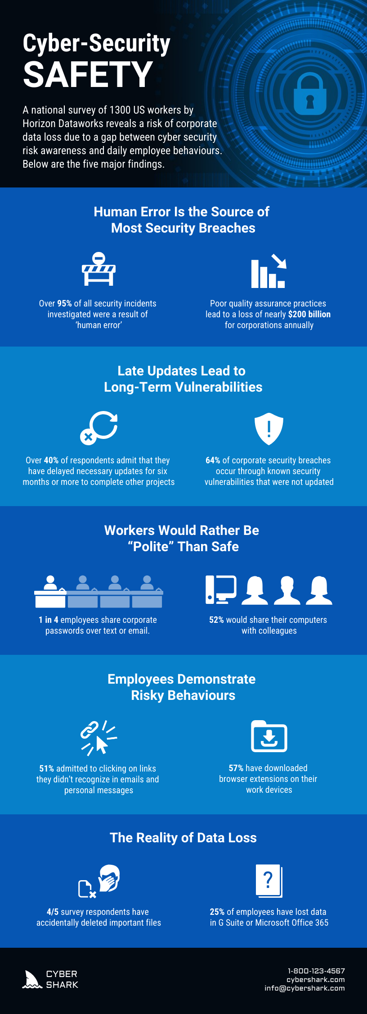
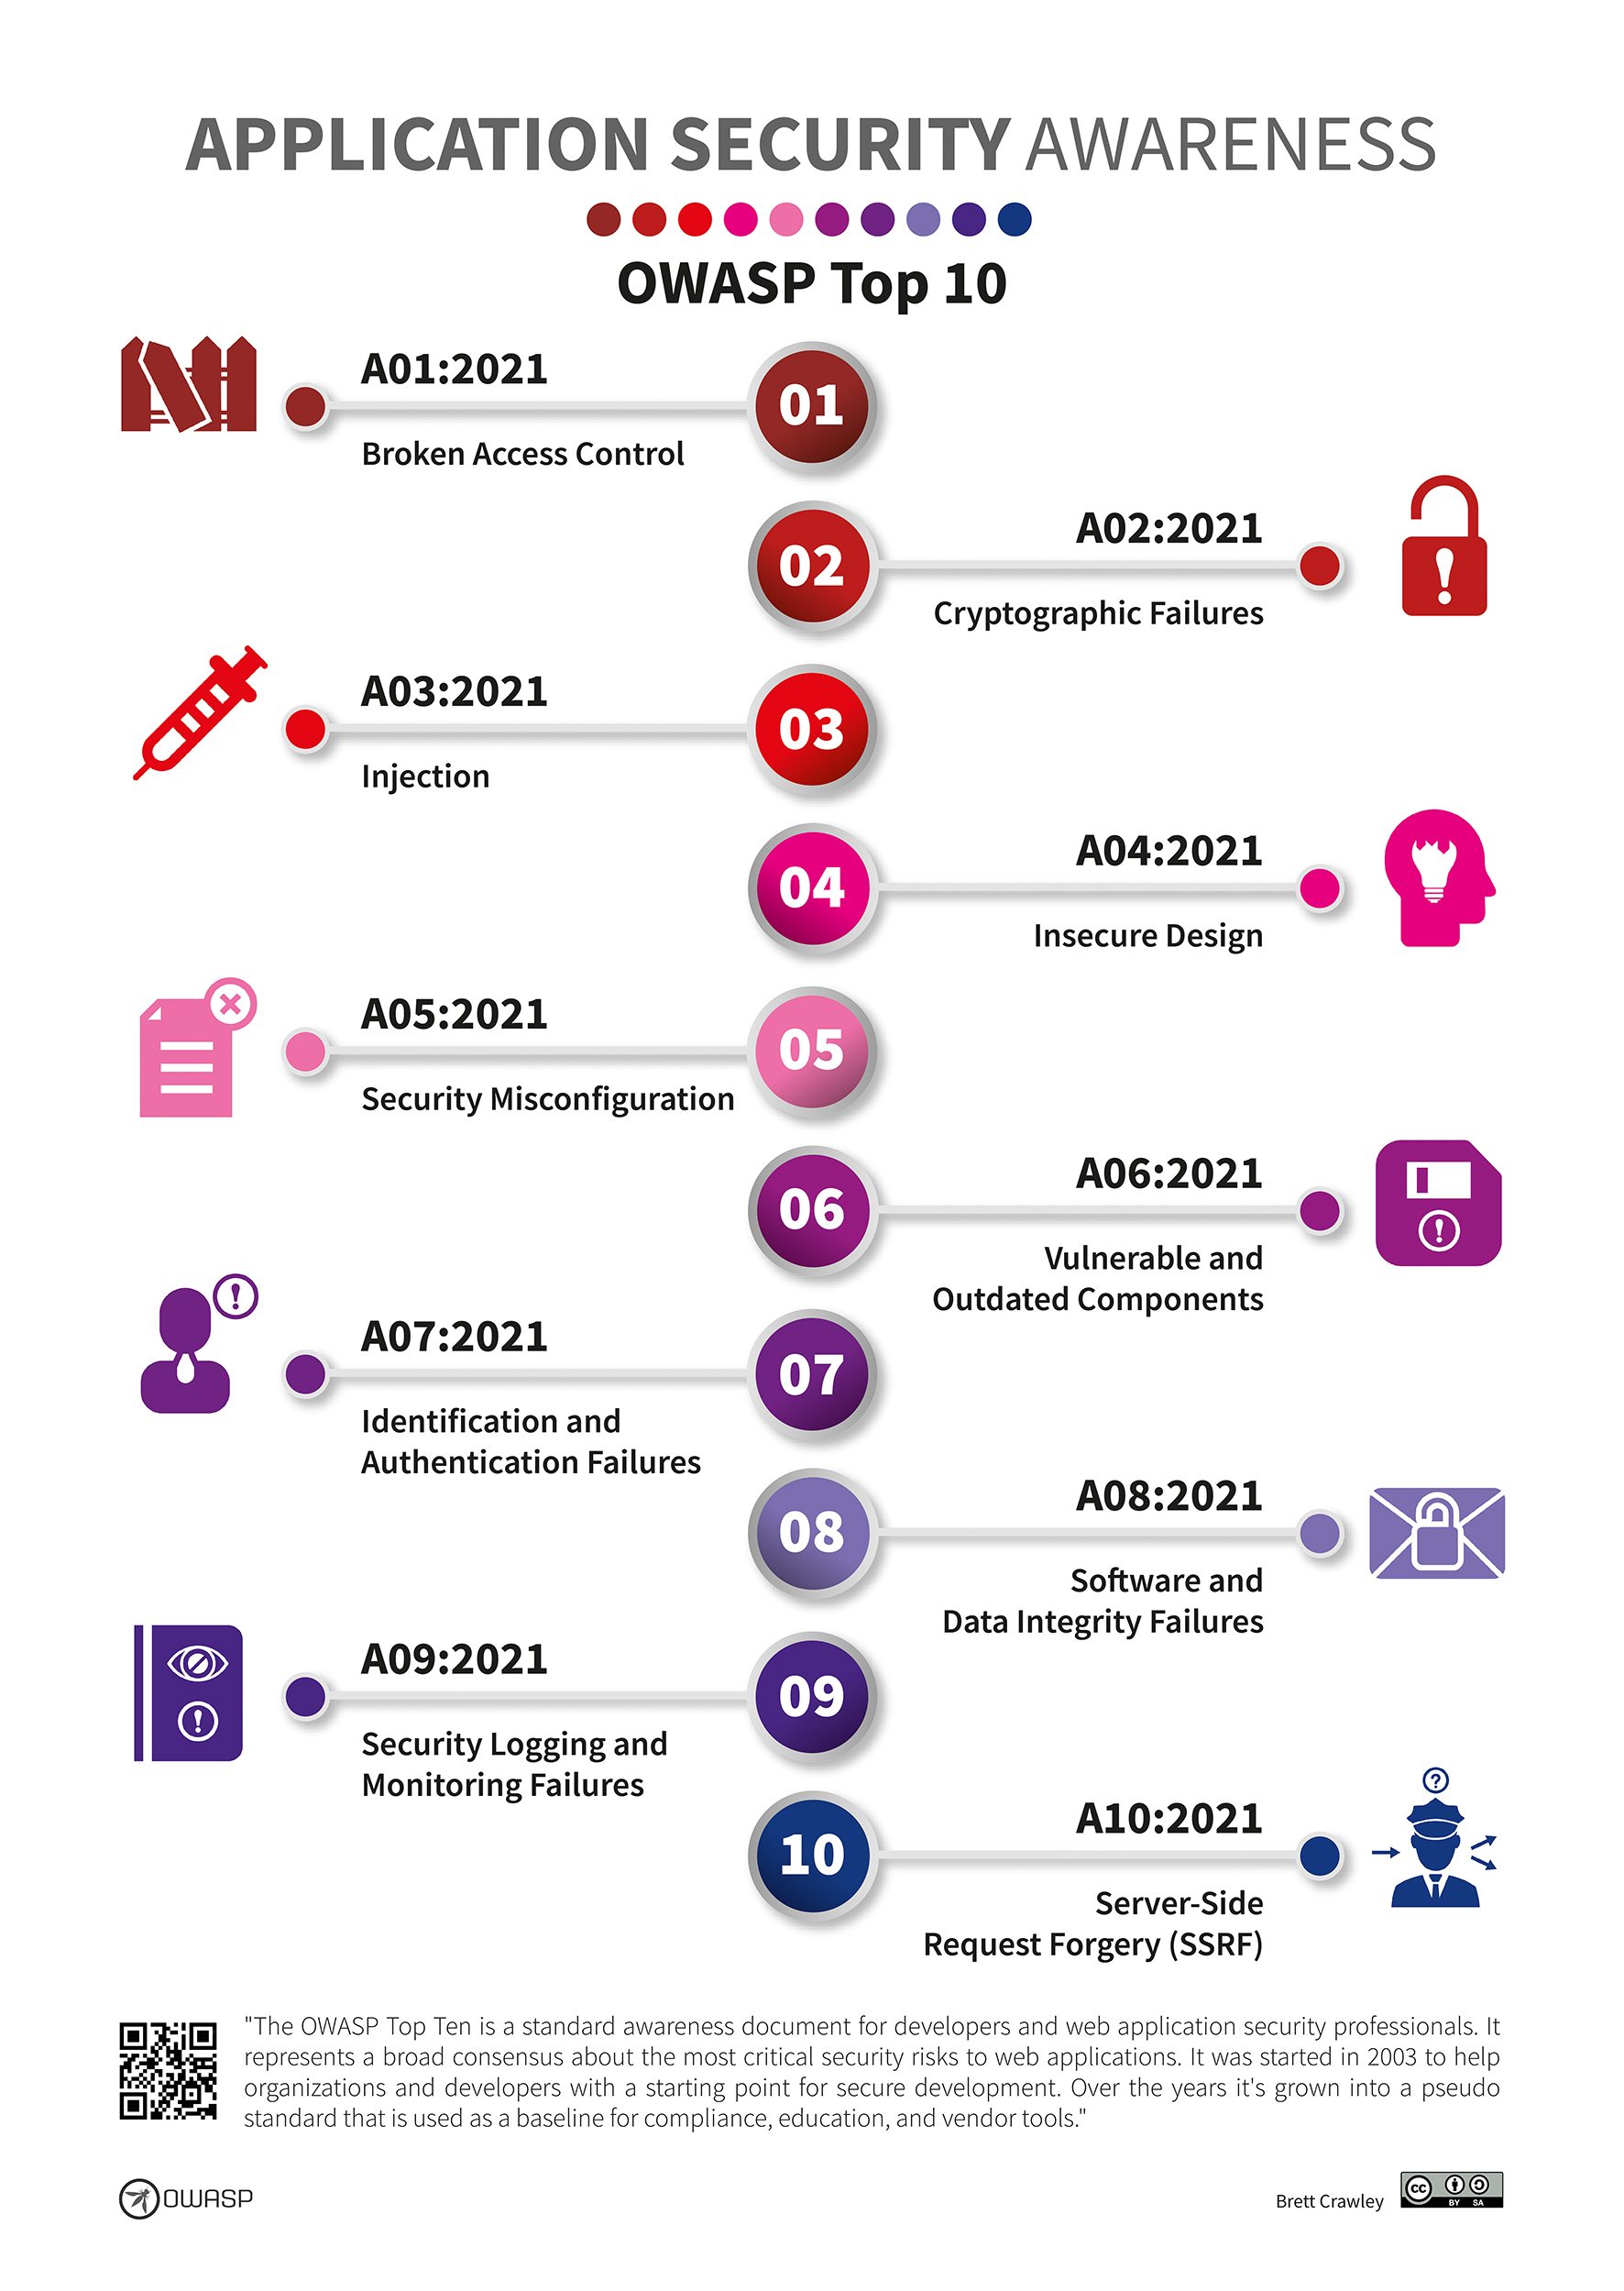
Cybersecurity Awareness Infographic

Slide 12
Executive Summary
Augusta Medical in Augusts, Ga.
Twenty-two Doctors and hundreds of staff serving over 10,000 patients
Mission
Our mission is to provide leadership and excellence in teaching, discovery, clinical care, and service as a student-centered comprehensive research university and academic health center, with a wide range of programs from learning assistance through postdoctoral studies.
Goals
Upgrading security and cybersecurity framework to comply with HIPAA
Upgrading systems and network to provide better care and information to patients

